Slide 1
SQL – Basics (More Practice)
CS 4710
Database Systems

Slide 2
Course Update
Assignment 1 uploaded and due on 02/13
Project Phase 2 due on 02/20
Zybook Assignment 1 due on 02/22 (Participation activity and Lab – everything is included)

Slide 3
Course Update
We will practice zybook in-class on this monday 02/09. Bring your laptops.
Midterm 1 on 02/16. Review class on 02/11.

Slide 4
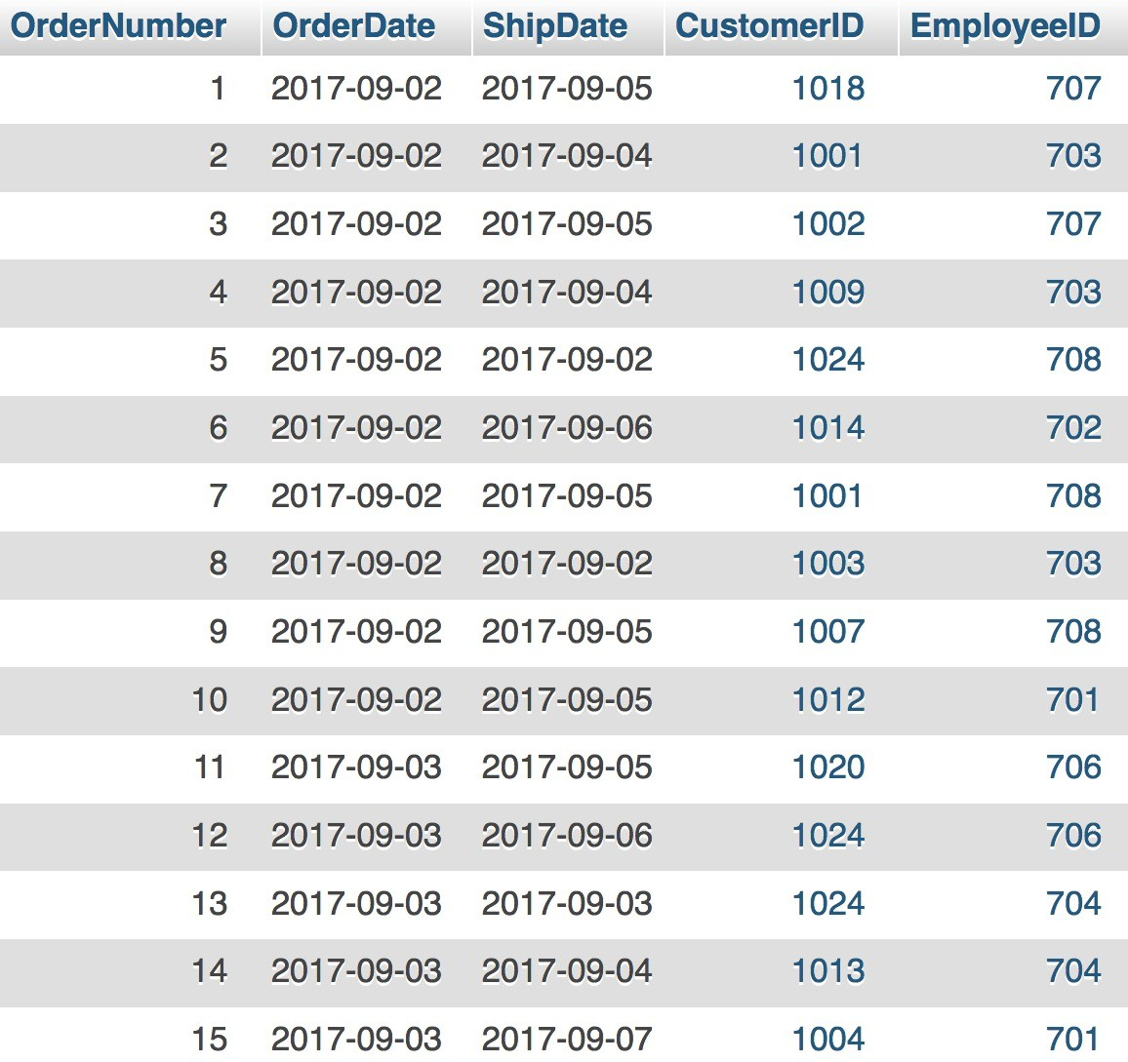
Example 1: Translate and Clean Up
Consider sample data of an Orders table. How many days elapsed between the order date and the ship date for each order?
Orders
Select the order number, order date, ship date, ship date minus order as DaysElapsed from the Orders table
Select the order number, order date, ship date, ship date minus order as DaysElapsed from the Orders table

Slide 5
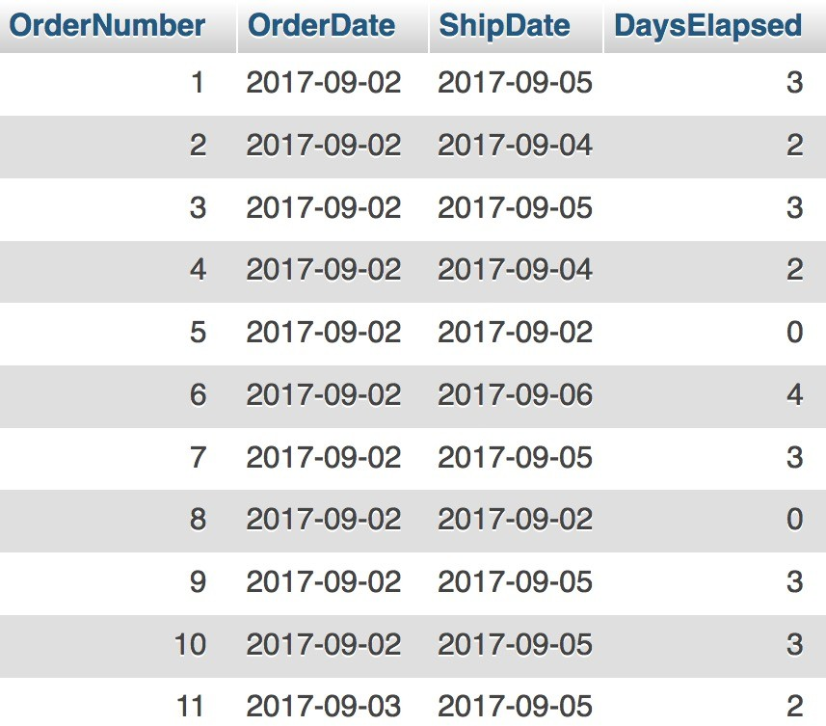
Example 1: Translate and Clean Up
Select the order number, order date, ship date, ship date minus order as DaysElapsed from the Orders table
SELECT OrderNumber,
OrderDate, ShipDate, (ShipDate - OrderDate) AS DaysElapsed
FROM Orders;
Note: rename the column header

Slide 6
Example 2: Translate and Clean Up
Consider sample data of an Orders table. Show me a list of orders made by each customer in descending date order
Orders
Select the customer ID, order number, order date, ship date, from the Orders table for each customer and then sort by customer and descending order date
Select the customer ID, order number, order date, ship date, from
the Orders table for each customer group by customer ID and then sort
by customer order by customer ID
and descending order date desc

Slide 7
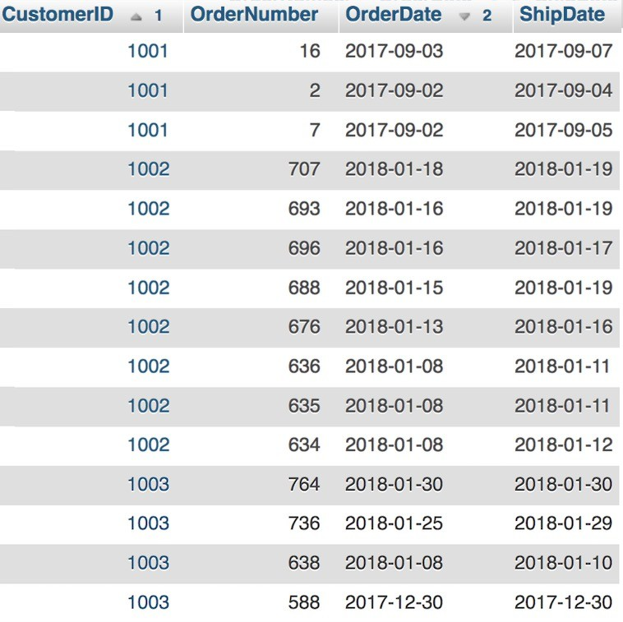
Example 2: Translate and Clean Up
Select the customer ID, order number, order date, ship date, from
the Orders table for each customer group by customer ID and then sort
by customer order by customer ID
and descending order date desc
SELECT CustomerID,
OrderNumber, OrderDate, ShipDate
FROM Orders
GROUP BY CustomerID,
OrderNumber ORDER BY CustomerID,
OrderDate DESC;
Note: Several DBMS requires that everything in “ORDER BY” must be in “GROUP BY” and everything in “GROUP BY” must be in “SELECT.” (MySQL doesn’t seem to enforce these requirements)

Slide 8
Recap 1: SELECT .. FROM .. WHERE
Student_lecture
S_id | Address | Course | Teaching_assistant
1234 | 57 Hockanum Blvd | Database Systems | Minnie
2345 | 1400 E. Bellows | Database Systems | Humpty
3456 | 900 S. Detroit | Cloud Computing | Dumpty
1234 | 57 Hockanum Blvd | Web Programming Lang. | Mickey
5678 | 2131 Forest Lake Ln. | Software Analysis | Minnie
Find Courses that Minnie is a TA. Also, list all S_id who takes those courses
SELECT distinct Course
FROM Student_lecture
WHERE Teaching_assistant= “Minnie”
SELECT S_id, Course
FROM Student_lecture
WHERE Teaching_assistant= “Minnie”

Slide 9
Recap 2: SELECT .. FROM .. WHERE
Student_lecture
S_id | Address | Course | Teaching_assistant
1234 | 57 Hockanum Blvd | Database Systems | Minnie
2345 | 1400 E. Bellows | Database Systems | Humpty
3456 | 900 S. Detroit | Cloud Computing | Dumpty
1234 | 57 Hockanum Blvd | Web Programming Lang. | Mickey
5678 | 2131 Forest Lake Ln. | Software Analysis | Minnie
Find all S_id who is taking Database Systems and have Humpty as a TA
SELECT S_id
FROM Student_lecture
WHERE Teaching_assistant= “Minnie” and
Course = “Database Systems”

Slide 10
Recap 3: SELECT .. FROM .. WHERE
hiring
TA_id | Name | Year | Two_week_hours
1234 | Minnie | 4 | 20
2345 | Humpty | 3 | 24
3456 | Dumpty | 4 | 30
3333 | Minnie | 3 | 12
5678 | Mickey | 2 | 16
List all names of TAs and the number of hours the TAs work per week, rename the hours as “Hours_per_week”
SELECT TA_id, Two_week_hours as “Hours_per_week”
FROM hiring

Slide 11
Recap 4: SELECT .. FROM .. WHERE
hiring
TA_id | Name | Year | Two_week_hours
1234 | Minnie | 4 | 20
2345 | Humpty | 3 | 24
3456 | Dumpty | 4 | 30
3333 | Minnie | 3 | 12
5678 | Mickey | 2 | 16
List all years
SELECT Year
FROM hiring

Slide 12
Recap 5: SELECT .. FROM .. WHERE
hiring
TA_id | Name | Year | Two_week_hours
1234 | Minnie | 4 | 20
2345 | Humpty | 3 | 24
3456 | Dumpty | 4 | 30
3333 | Minnie | 3 | 12
5678 | Mickey | 2 | 16
List all years the TAs are in. If multiple TAs are in the same year, list the year only once
SELECT distinct Year
FROM hiring

Slide 13
Aggregation Functions
Calculate a value across an entire set or across groups of rows within the set
SQL uses five aggregation operators:
SUM – produces the sum of a column with numerical values
AVG – produces the average of a column with numerical values
MIN – applied to a column with numerical values, produces the smallest value
MAX – applied to a column with numerical values, produces the largest value
COUNT – produces the number of (not necessarily distinct) values in a column

Slide 14
Example: SUM
Given the loan schema
loan(loan_number,
branch_name,
amount)
loan_number | branch_name | amount
L-11 | Round Hill | 900
L-14 | Downtown | 1500
L-15 | Perryridge | 1500
L-16 | Perryridge | 1300
L-17 | Downtown | 1000
L-23 | Redwood | 2000
L-93 | Mianus | 500
The sum of the amounts of all loans is expressed by
SELECT SUM(amount) FROM loan
SELECT SUM(amount) AS Total FROM loan
SUM(amount)
Total
8700
8700

Slide 15
Example: AVG
Given the loan schema
loan(loan_number,
branch_name,
amount)
loan_number | branch_name | amount
L-11 | Round Hill | 900
L-14 | Downtown | 1500
L-15 | Perryridge | 1500
L-16 | Perryridge | 1300
L-17 | Downtown | 1000
L-23 | Redwood | 2000
L-93 | Mianus | 500
The average of the amounts of all loans is expressed by
SELECT AVG(amount) FROM loan
AVG(amount)
1242.857142857143

Slide 16
Example: MIN
Given the loan schema
loan(loan_number,
branch_name,
amount)
loan_number | branch_name | amount
L-11 | Round Hill | 900
L-14 | Downtown | 1500
L-15 | Perryridge | 1500
L-16 | Perryridge | 1300
L-17 | Downtown | 1000
L-23 | Redwood | 2000
L-93 | Mianus | 500
The smallest amount of loans is expressed by
SELECT MIN(amount) FROM loan
min(amount)
500

Slide 17
Example: MAX
Given the loan schema
loan(loan_number,
branch_name,
amount)
loan_number | branch_name | amount
L-11 | Round Hill | 900
L-14 | Downtown | 1500
L-15 | Perryridge | 1500
L-16 | Perryridge | 1300
L-17 | Downtown | 1000
L-23 | Redwood | 2000
L-93 | Mianus | 500
The largest amount of loans is expressed by
SELECT MAX(amount) FROM loan
max(amount)
2000

Slide 18
Example: COUNT
Given the loan schema
loan(loan_number, branch_name, amount)
loan_number | branch_name | amount
L-11 | Round Hill | 900
L-14 | Downtown | 1500
L-15 | Perryridge | 1500
L-16 | Perryridge | 1300
L-17 | Downtown | 1000
L-23 | Redwood | 2000
L-93 | Mianus | 500
Count the number of tuples in the loan table
SELECT count(*) SELECT count(loan_number)
FROM loan FROM loan
Count
Count values of a specified column
count(*)
rows
Count(loan_number)
7
7

Slide 19
Example: COUNT .. DISTINCT
Given the loan schema
loan(loan_number, branch_name, amount)
loan_number | branch_name | amount
L-11 | Round Hill | 900
L-14 | Downtown | 1500
L-15 | Perryridge | 1500
L-16 | Perryridge | 1300
L-17 | Downtown | 1000
L-23 | Redwood | 2000
L-93 | Mianus | 500
Count the number of values in the branch_name column
SELECT count(branch_name) FROM loan
SELECT count(DISTINCT branch_name) FROM loan
count(branch_name)
count(distinct branch_name)
7
5

Slide 20

Aggregation: Order of Actions
SELECT select_list
FROM table_source
[WHERE search_condition] [GROUP BY group_by_expression] [HAVING search_condition]
[ORDER BY order_expression [ASC | DESC] ]
Order matter
The FROM clause generates the data set
The WHERE clause filters the data set generated by the FROM clause
The GROUP BY clause aggregates the data set that was filtered by the WHERE clause (note: GROUP BY does not sort the result set)
The HAVING clause filters the data set that was aggregated by the GROUP BY clause
The SELECT clause transforms the filtered aggregated data set
The ORDER BY clause sorts the transformed data set

Slide 21


Grouping Requirement
Several DBMS requires that the columns appear in the GROUP BY clause that are not used in an aggregation function must appear in the SELECT clause
SELECT column_A, column_B, some_aggregation_function
FROM table_source
GROUP BY column_A, column_B
SELECT
column_A, column_B, some_aggregation_function
FROM table_source
GROUP BY column_B

Slide 22
Example: SUM with GROUP BY
Given the loan schema
loan(loan_number, branch_name, amount)
loan_number | branch_name | amount
L-11 | Round Hill | 900
L-14 | Downtown | 1500
L-15 | Perryridge | 1500
L-16 | Perryridge | 1300
L-17 | Downtown | 1000
L-23 | Redwood | 2000
L-93 | Mianus | 500
The sum of the amounts of all loans for each branch is expressed by
branch_name | SUM(amount)
Downtown | 2500
Mianus | 500
Perryridge | 2800
Redwood | 2000
Round Hill | 900
SELECT branch_name, SUM(amount) FROM loan
GROUP BY branch_name;

Slide 23
Grouping, Aggregation, and Null
The value NULL is ignored in any aggregation
Not contribute to a sum, average, or count of an attribute
Cannot be the minimum or maximum in its column
Null is treated as an ordinary value when forming groups
Can have a group with NULL attribute(s)
When performing any aggregation except count over an empty bag of values, the result is NULL
The count of an empty bag is 0

Slide 24
HAVING Clauses
An aggregation in a HAVING clause applies only to the tuples of the group being tested – filter groups
Any attributes of relations in the FROM clause may be aggregated in the HAVING clause
But only those attributes that are in the GROUP BY list may appear unaggregated in the having clause
The sum of the amounts of all loans for each branch that has more than one loan is expressed by
SELECT branch_name, sum(amount) FROM loan
GROUP BY branch_name
HAVING COUNT(branch_name) > 1;
branch_name | SUM(amount)
Downtown | 2500
Perryridge | 2800

Slide 25
Example 1
List the number of customers in each country. Only include countries with more than 10 customers
SELECT count(id), country FROM Customer
GROUP BY country HAVING COUNT(id) > 10;
count(id) | Country
11 | France
11 | Germany
13 | USA

Slide 26
Example 2
List the number of customers in each country, except USA, sorted high to low. Only include countries with 9 or more customers
SELECT COUNT(id), country
FROM WHERE GROUP
Customer
country <> “USA”
BY country
HAVING COUNT(id) >= 9
DESC;
ORDER BY COUNT(id)
count(id) | Country
11 | France
11 | Germany
9 | Brazil

Slide 27
Final Notes about Aggregation
#1: Keep the GROUP BY clause small and precise
Several DBMSs require that all non-aggregated columns must be in the GROUP BY clause
Excessive columns in GROUP BY can negatively impact the query’s performance; make the query hard to read, understand, rewrite
For queries that need both aggregations and details, do all aggregations in subqueries first, then join those to the tables to retrieve the details

Slide 28
Final Notes about Aggregation
#2: COUNT(*) and COUNT(<column_name>) are different
COUNT(*) – count all rows, including ones with null values
COUNT(<column_name>) – count only the rows where the column value is not NULL
Sometimes, dividing a query into subqueies can be more efficient than using a GROUP BY (more about subqueries next week)

Slide 29
Final Notes about Aggregation
#3: Use DISTINCT to get distinct counts
COUNT(*) – returns the number of rows in a group, including NULL value and duplicates
COUNT(<column_name>) – returns the number of rows where the column value is not NULL
COUNT(DISTINCT <column_name>) – returns the number of rows with unique, non-null values of the column

Slide 30
Wrap-Up
Aggregation functions
Order of actions matter when applying aggregation
Aggregation helps make decisions and succinctly convey information
What’s next?
SQL – Joins
Combine techniques (aggregates and joins) to solve complex questions

Slide 31
Zybook Task
Let’s do 2.14-2.16, 2.19 in class
At home task:2.17-18, 2.20-21

